Slide 1
European Baccalaureate
2024 - 2025

Slide 2
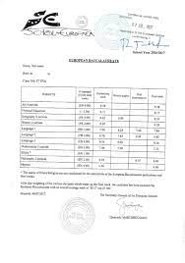
THE EUROPEAN BACCALAUREATE
A QUICK OVERVIEW

Slide 3
THE EUROPEAN BACCALAUREATE CYCLE
Comprises the two last years of secondary education (s6 and s7) in the European Schools or in Schools Accredited by the Board of Governors.

Slide 4
IMPORTANT DATES – S7
Selection of oral and written examinations due – 27th of September

Slide 5
IMPORTANT DATES – S6

Slide 6
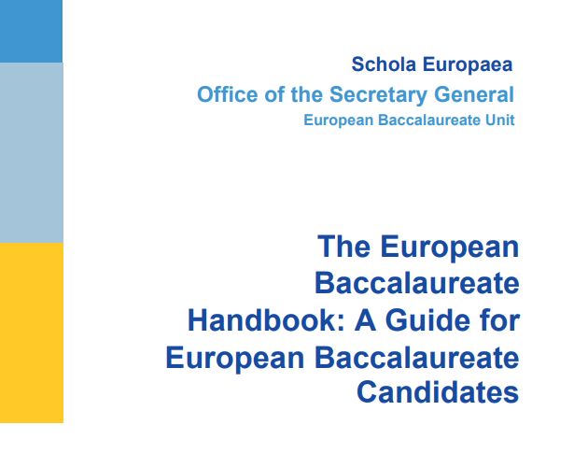
THE GUIDE
https://www.eursc.eu/Documents/BAC_Handbook-en.pdf

Slide 7
REGISTRATION OF BAC EXAMS
Via the application form contained in Annex I
Add copy of the birth certificate / passport
All students must submit an e-mail address valid until the end of the school year.
• The registration fee for the BAC Exam 2024- 25
• After registration this amount will be billed by our bookkeeping department on the 31st of March 2025

Slide 8
WRITTEN AND ORAL EXAMINATIONS CHOICES

Slide 10
GENERAL EXPLANATION – MARKING
At the end of s7, the pupils obtain a preliminary mark (C Mark), which represents 50% of the final mark. The other 50 % = the BAC written and oral examinations.
The preliminary mark reflects all the formative assessment and summative assessment (Pre-Baccalaureate examinations) carried out by the teachers during s7.

Slide 11
THE MARKING SCALE
w
C
O
Visual Representation of mark weighting for a candidate with 12 subjects

Slide 12
WEIGHTING OF SUBJECTS AND EXAMS
Please note: The number of periods of a subject does not have an influence on its weight.
The value of the different subjects depends only on whether you take them as oral or written examinations.
Remember that the pass mark in the European Baccalaureate is 5/10.

Slide 13
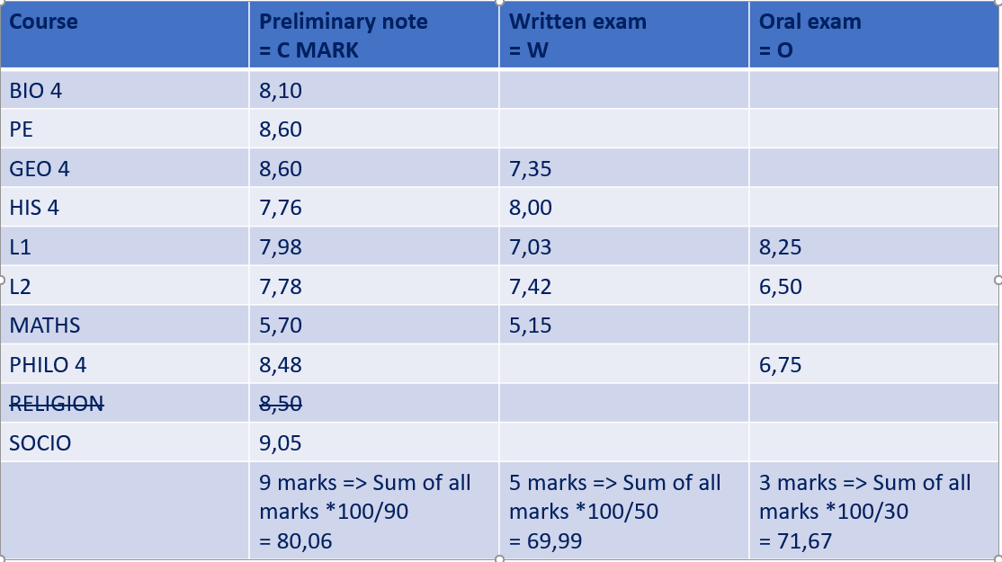
WEIGHTING OF SUBJECTS AND EXAMS
Final mark = 0,5 * C + 0,35 * W + 0,15 * O
= 0,5 * 80,06 + 0,35 * 69,99 + 0,15 * 71,07
= 40,03 + 24,49 + 10,66
= 75,18 %

Slide 14
CORRECTIONS
Both written and oral examinations are subject to double correction and marking by both the candidates’ teachers and external examiners.
The final mark will be the average of the two examiners’ marks.
In the case of a mark-disagreement of over two points, a third external corrector will be brought in and will establish through a thorough analysis of the previous corrections a final mark between the highest and the lowest awarded by the two previous correctors.

Slide 15
ADDITIONAL EXAMS
13.1 In particular cases, European School pupils in the final school year may register for the European Baccalaureate in an additional option subject, whether or not they have attended lessons in the subject in question at the School. However, in the case of Music and Art, due to specific syllabus requirements, an additional exam can only be applied for if the pupil has followed the subject or if he provides evidence of the prescribed work done during s6 and s7 so as to ensure that the syllabus requirements are met.
13.2 Additional European Baccalaureate examinations will be authorized by the Secretary-General of the European Schools only if documentation is provided to show that an examination in the subject is part of the conditions for admission to the higher education studies on which the pupil wishes to embark. This does not concern the linguistic competence required to be admitted in an institution of further education. For certification of language competences, candidates should address official centres of language competence certification.

Slide 16
COSTS
Registration fee for the year 2024-2025: 103.90 euros
Usual cost per oral exam: 100 euros
Overall cost per candidate (estimated): 403.90 euros
Cost for additional exam: 37.42 euros
The fee will be invoiced in March 2025

Slide 17
CLASS TEACHER TIME

Slide 18
CLASS TEACHER TIME
Secondary 7 -Jennifer
Secondary 6 – Tom and Liina
We are a team and please feel free to contact either of us with any questions or issues that may arise.

Slide 19
NEW SYSTEM – NEW CULTURE
Three big points we would like to promote and instill in our students:
Trust and respect
Academic responsibility
Privilege not a right

Slide 20
CLASS TEACHER TIME
Will focus on:
School / home balance
Mental health
Universities ( research and applications )
Careers advice
Private study
Reviews with class teachers
Study skills

Slide 21
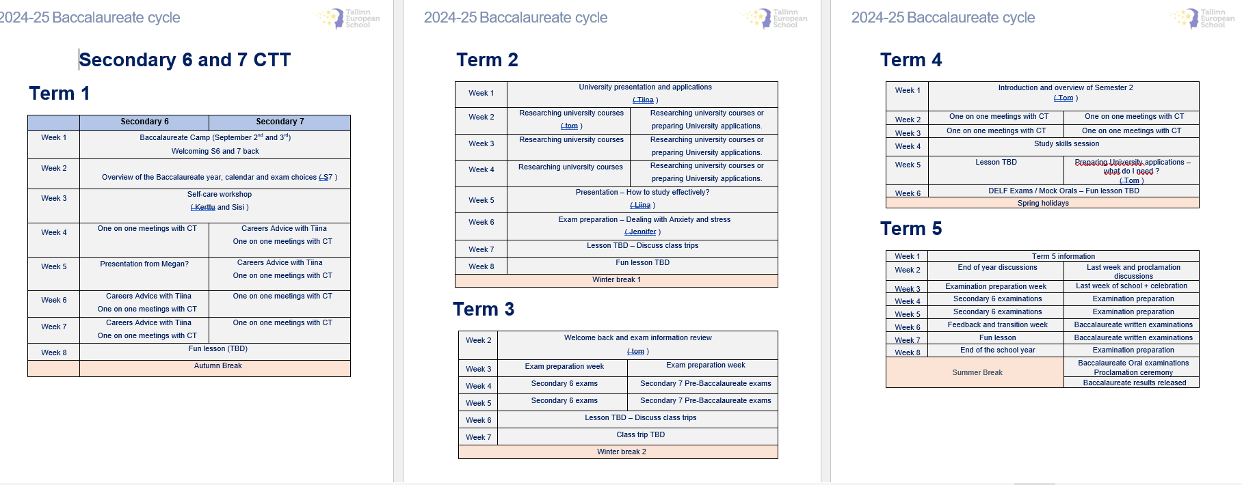
CLASS TEACHER TIME

Slide 22
STUDY ROOM - 138

Slide 23
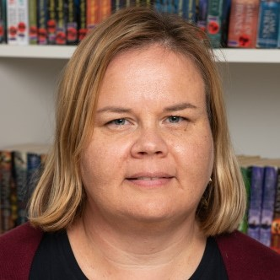
UNIVERSITY APPLICATIONS
If you need help or need to know more, please visit,
Mrs. Tiina Mäkelä is Tallinn Europeans school career guidance councilor. Ask questions – Be informed – Take responsibility

Slide 24
UNIVERSITY APPLICATIONS
European Network of information Centers in European Region ​
https://www.enic-naric.net/individual-wishing-to-studywork-abroad.aspx ​
Scholarships​
Eurodesk opportunity finder; Grants​
https://programmes.eurodesk.eu/grants

Slide 25
IF YOU HAVE ANY QUESTIONS OR CONCERNS - Firstly, please ask your child to come and talk to one of us. - Secondly, please send an email or book a meeting with us.

